Slide 1
Multi-agent path finding with formation
Guanzhi Chen 2149112

Slide 2
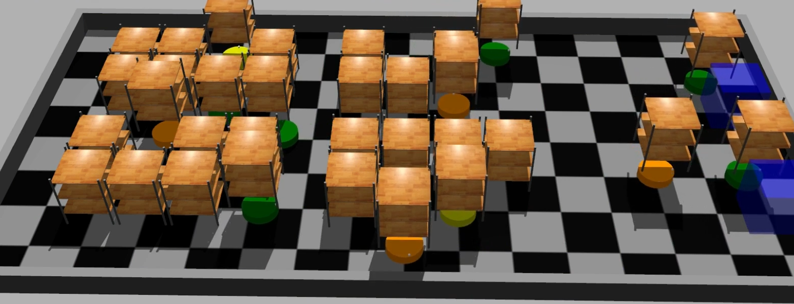
What is multi-agent path finding?
computing collision-free paths for a group of agents from their starting locations to goal locations.
Notes:
reeduce

Slide 3
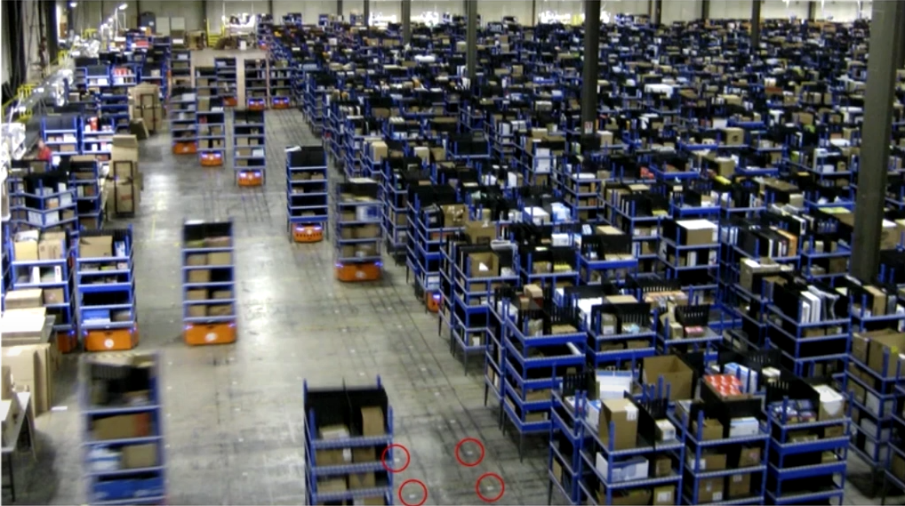
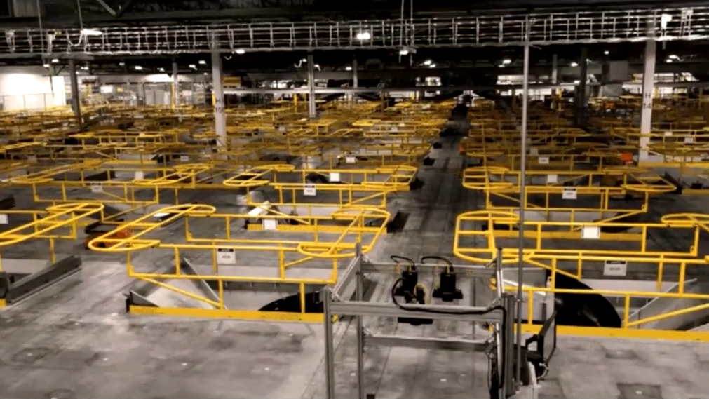
Amazon warehouse sorting centre
https://www.youtube.com/watch?v=H3wRCZf_Mrs

Slide 4
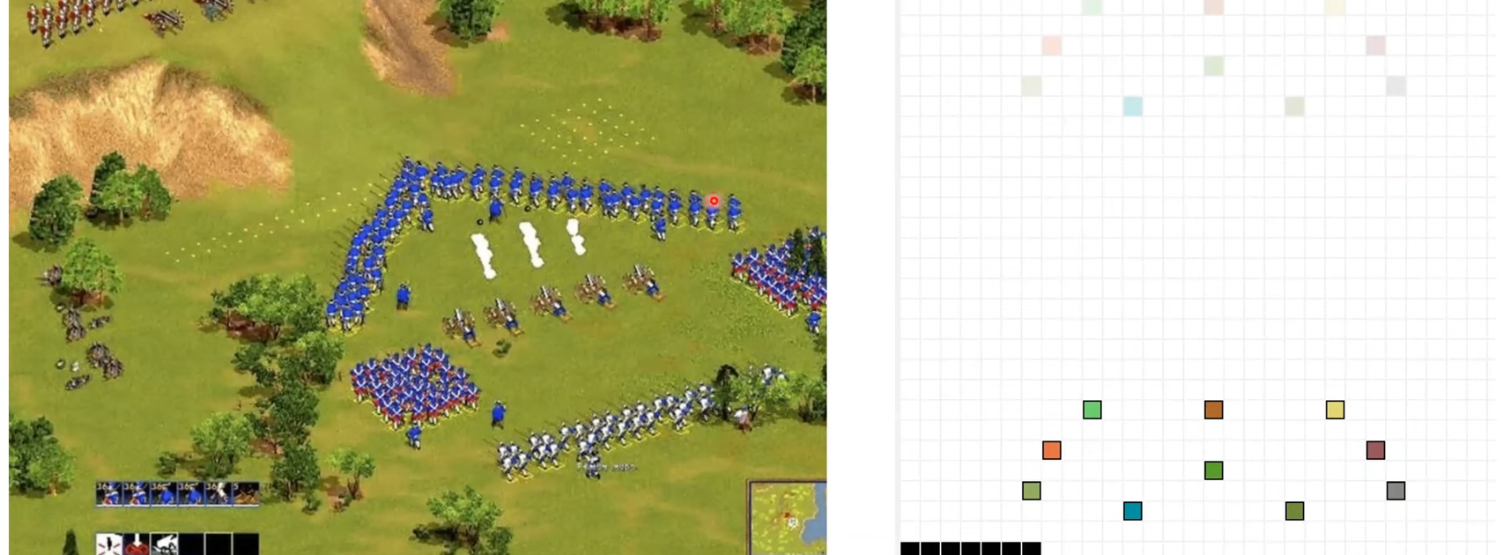
Moving in formation for video games
https://www.youtube.com/watch?v=H3wRCZf_Mrs

Slide 5
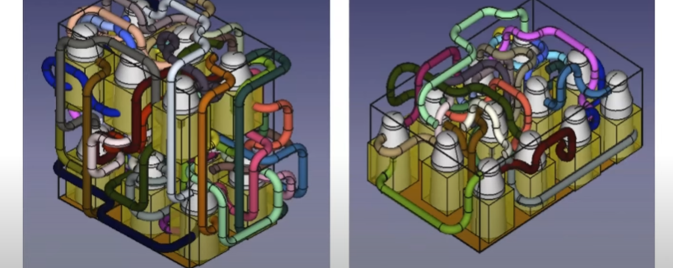
Pipe routing
https://www.youtube.com/watch?v=H3wRCZf_Mrs

Slide 6
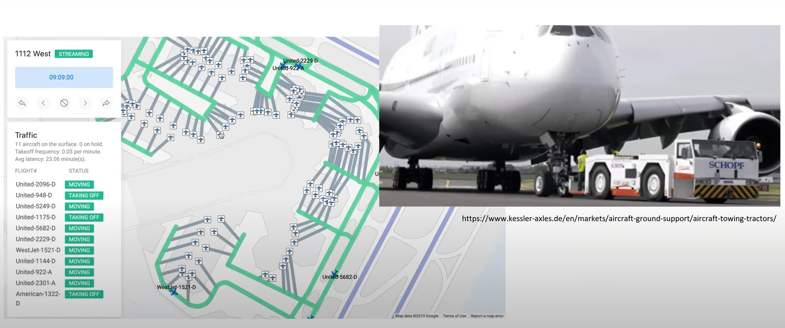
Airport surface operation
https://www.youtube.com/watch?v=H3wRCZf_Mrs

Slide 7
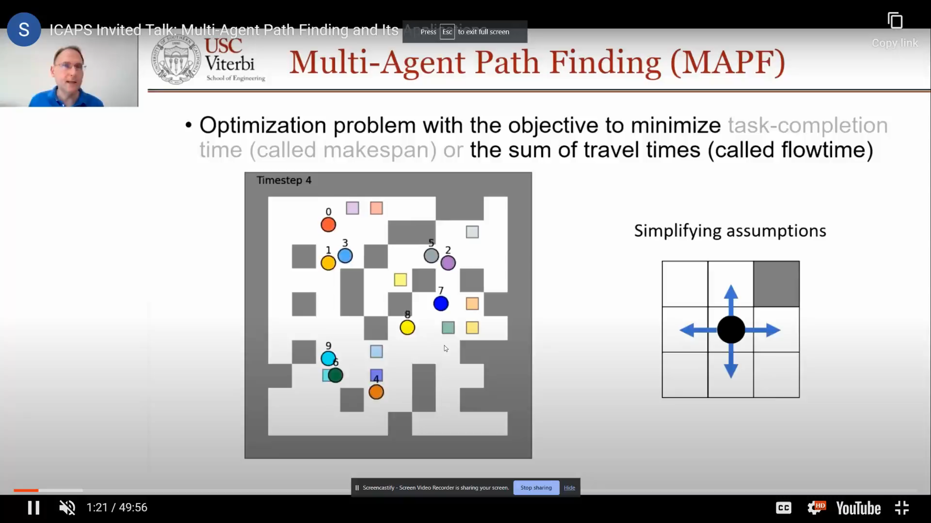
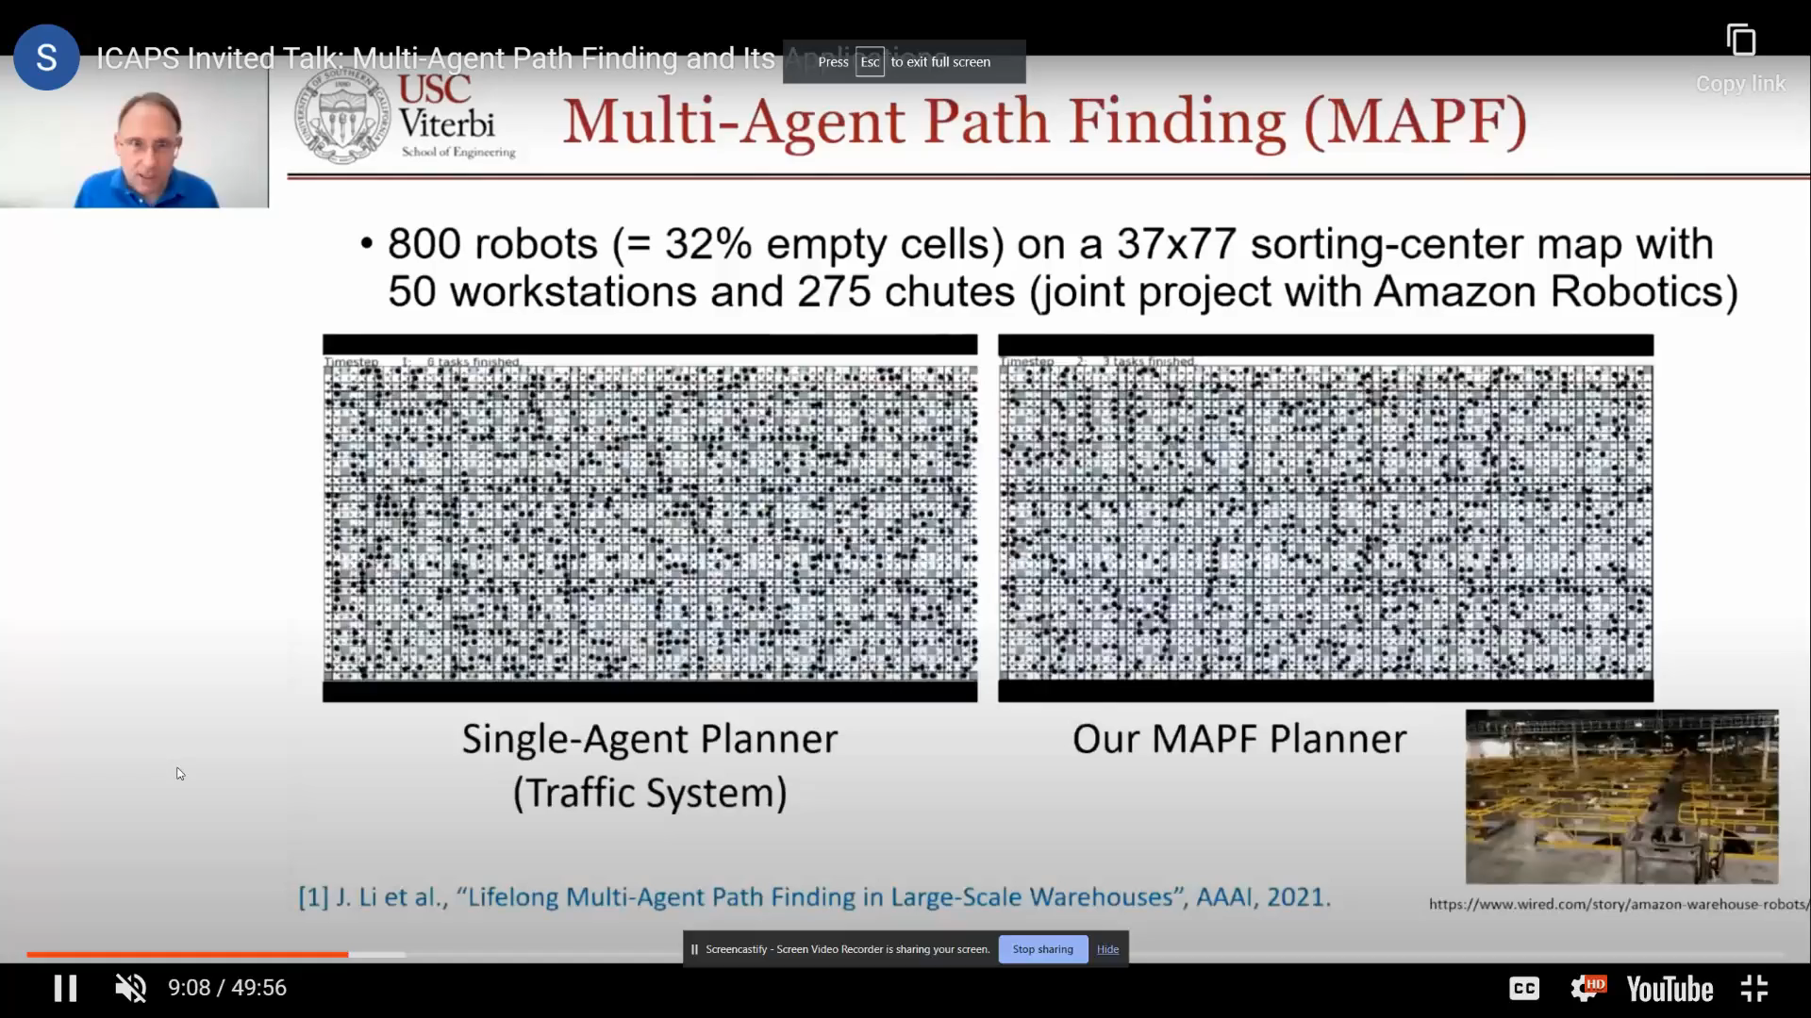
Conventional MAPF - CBS
guarantees optimal solutions
http://mapf.info/index.php/Main/Tutorials
Guni Sharon, Roni Stern, Ariel Felner, Nathan R. Sturtevant,
Conflict-based search for optimal multi-agent pathfinding,
Artificial Intelligence, Volume 219, 2015, Pages 40-66, ISSN 0004-3702

Slide 8
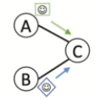
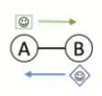
CBS step
1. Individual agent’s path-finding with special A* search while ignoring all the other agents’ paths.
2. Check the paths for all agents in pairs, solve conflicts:
1. Vertex conflict
2. Swap conflict
https://en.wikipedia.org/wiki/Multi-agent_pathfinding

Slide 9
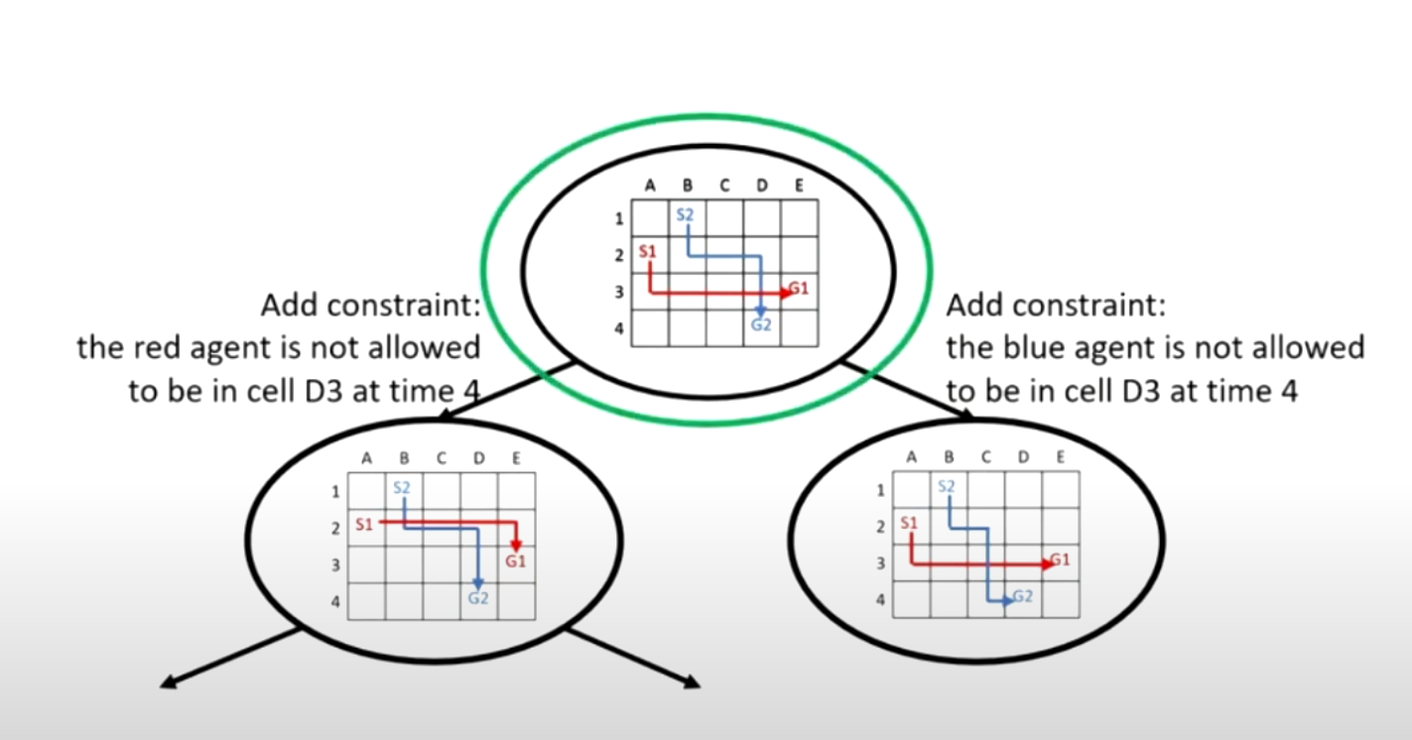
CBS step
http://mapf.info/index.php/Main/Tutorials
Notes:
3. Once a conflict is found, add the conflict to a constraint tree in the format of { Agent ID, Cell, time }(vertex conflict)/{Agent ID, Cell1, Cell2, time}(swap conflict).
4. Solve individuals’ pathfinding with the constraints in the constraint tree.
5. Search for new conflicts, add constraints to a new node in the tree and solve until no conflicts in the route for all agents.

Slide 10
Vertex conflict
1. Agent A prohibited at Cell C for time t;
2. Agent B prohibited at Cell C for time t;
A
C
B
A
C
B

Slide 11
Swap conflict
1. Agent A is prohibited at the Cell where B was for the next move.
2. Agent B is prohibited at the Cell where A was for the next move
A
B
A
B

Slide 12
Swap conflict
1. Agent A is prohibited at the Cell where B was and where A was for the next move.
2. Agent B is prohibited at the Cell where A was and where B was for the next move
A
B
A
B

Slide 13
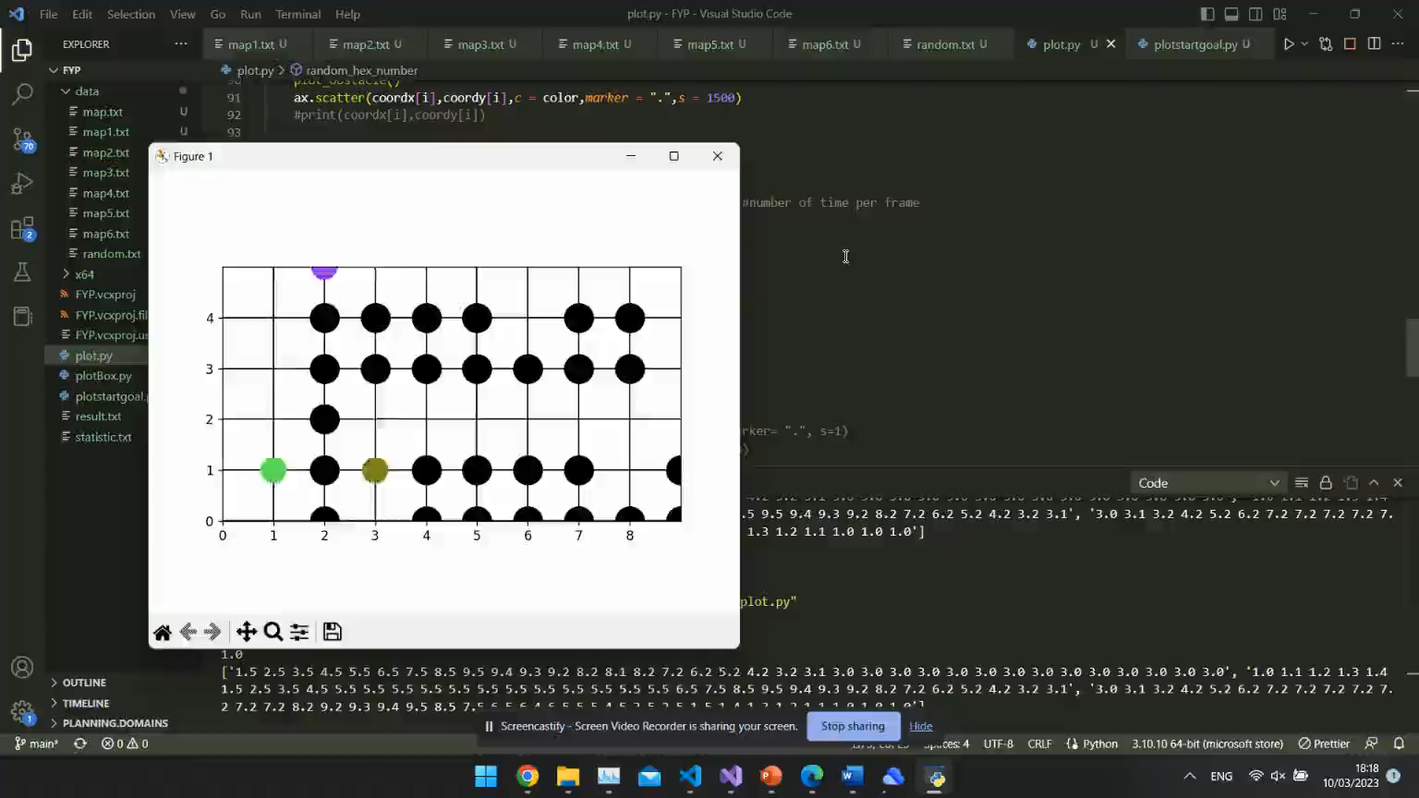
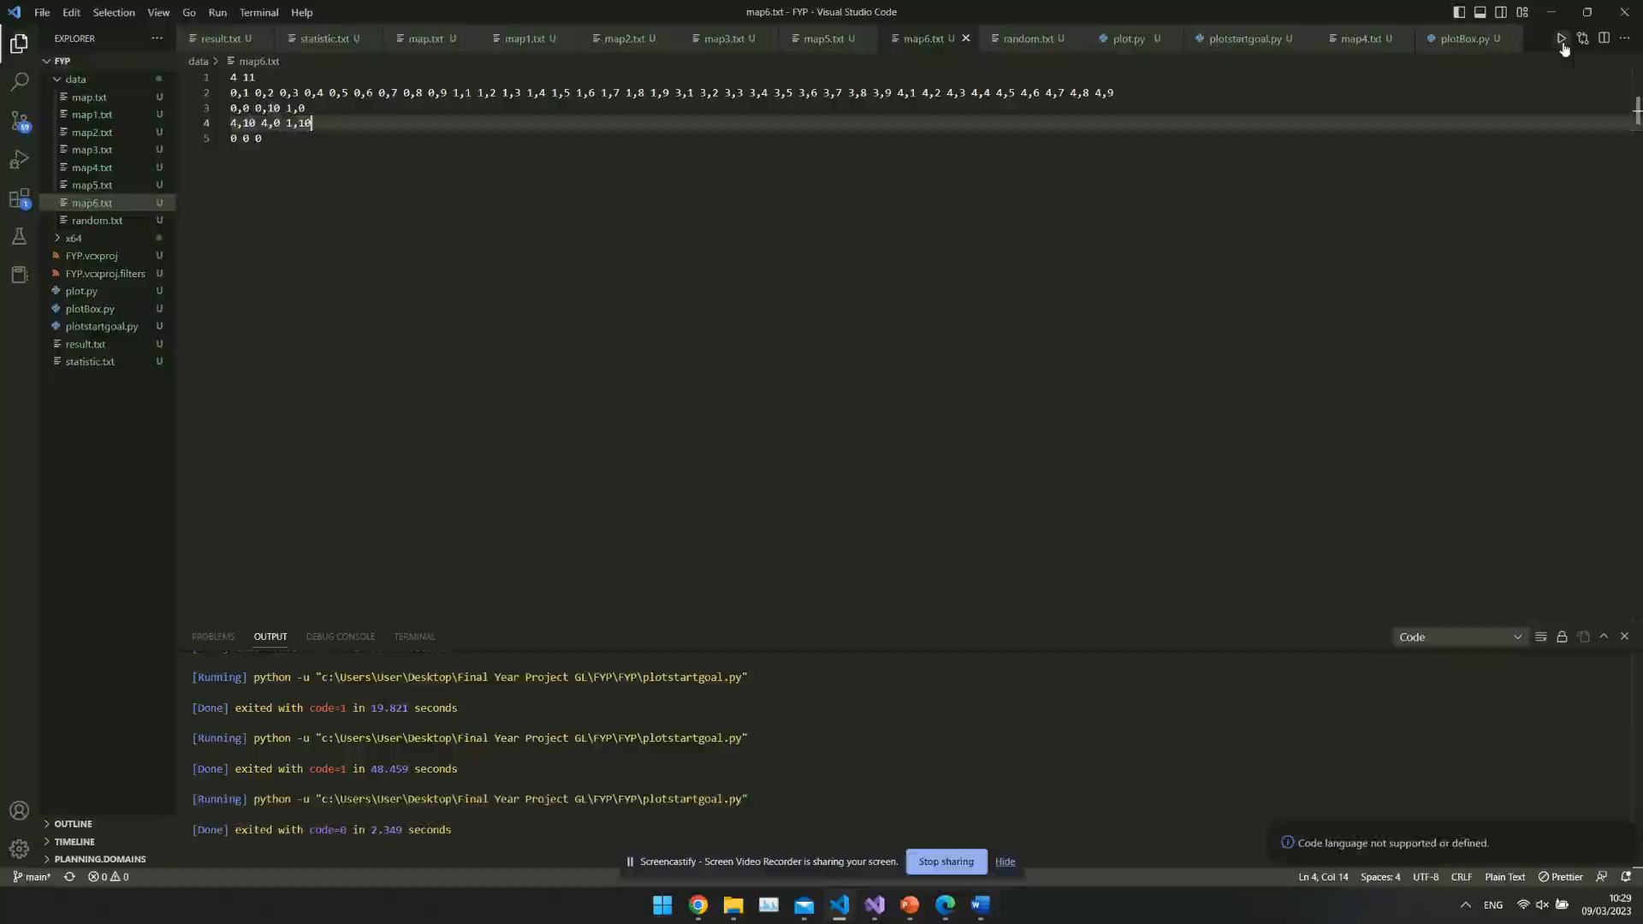
Notes:
Future work: 3D, different shape

Slide 14
Definition of MAPF problem with formation (MAPF-F)
New robot:
Group of robots,
with four individual robots at the corner of the square,
keep the same formation during movement.
Map combined with groups of robots of different sizes and single robots.

Slide 15
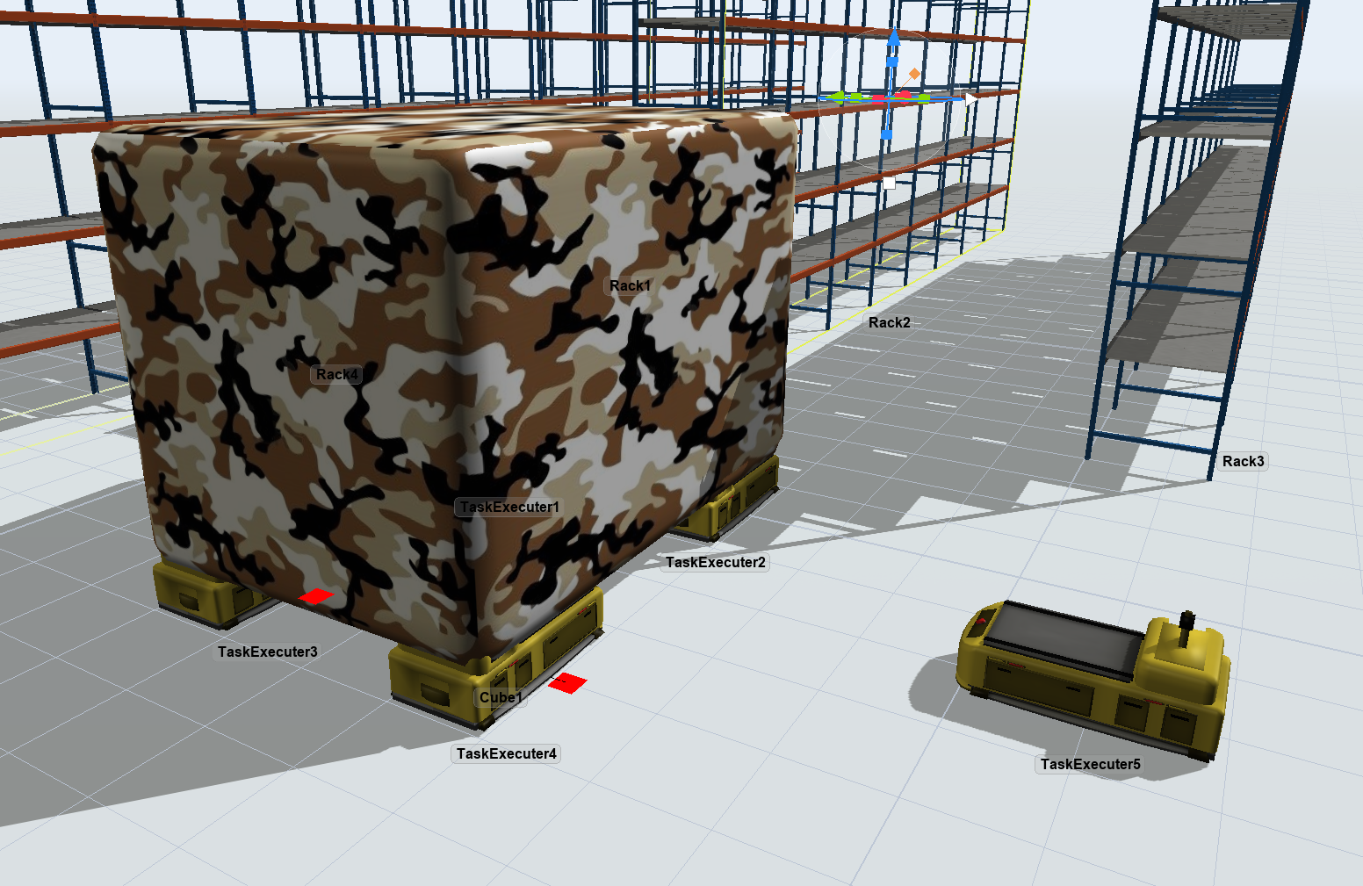
Application

Slide 16
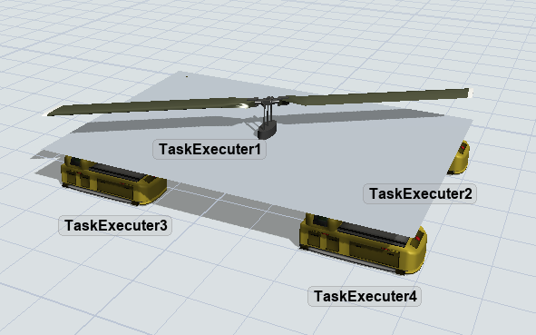

Slide 17
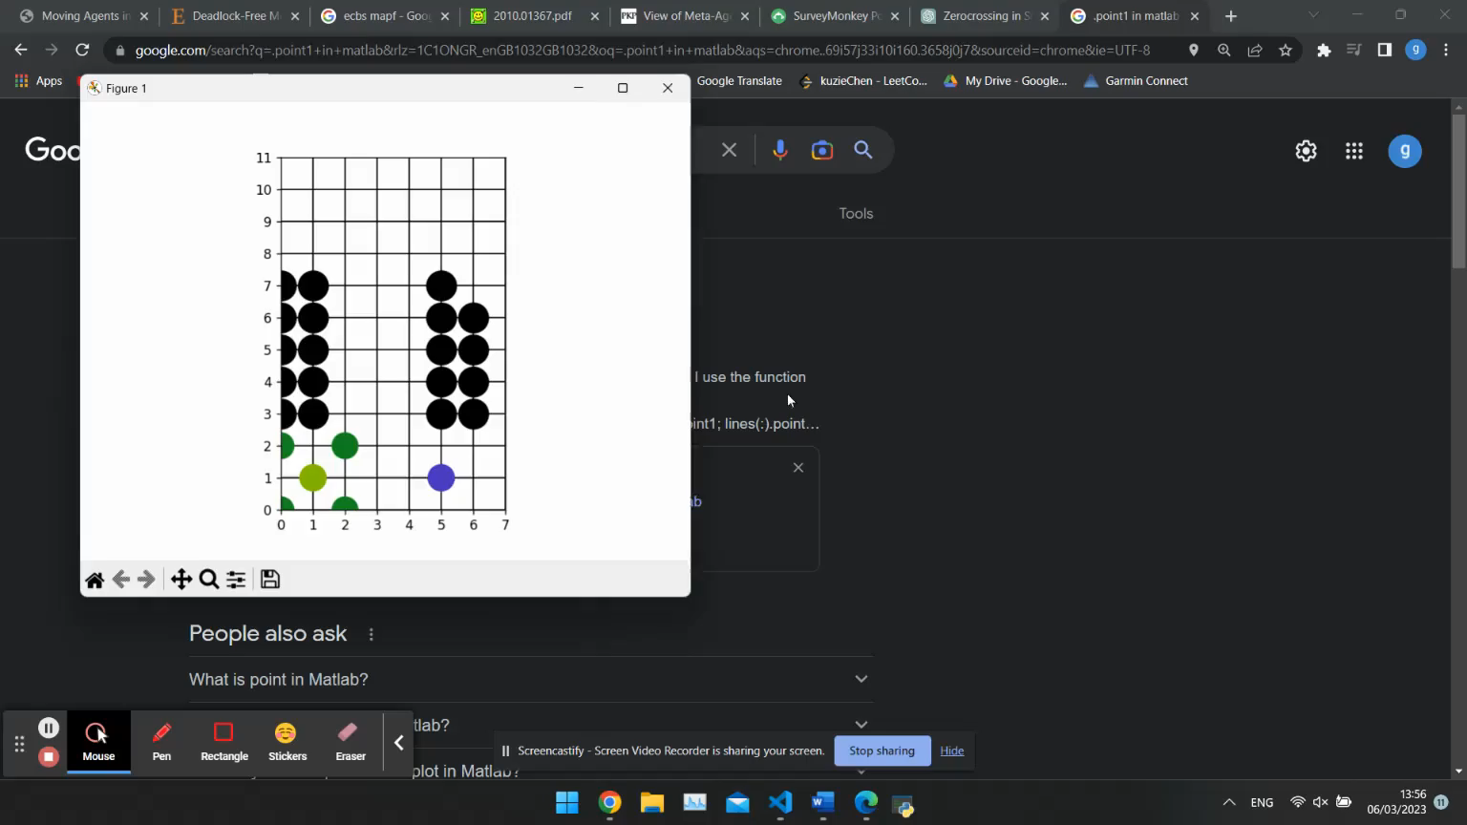
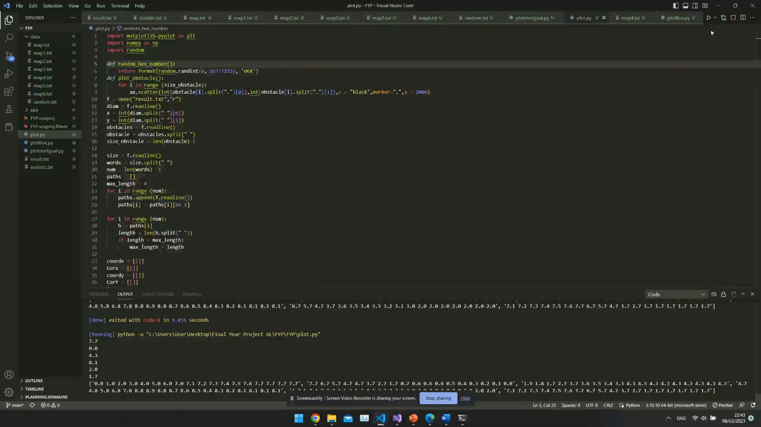

Slide 18
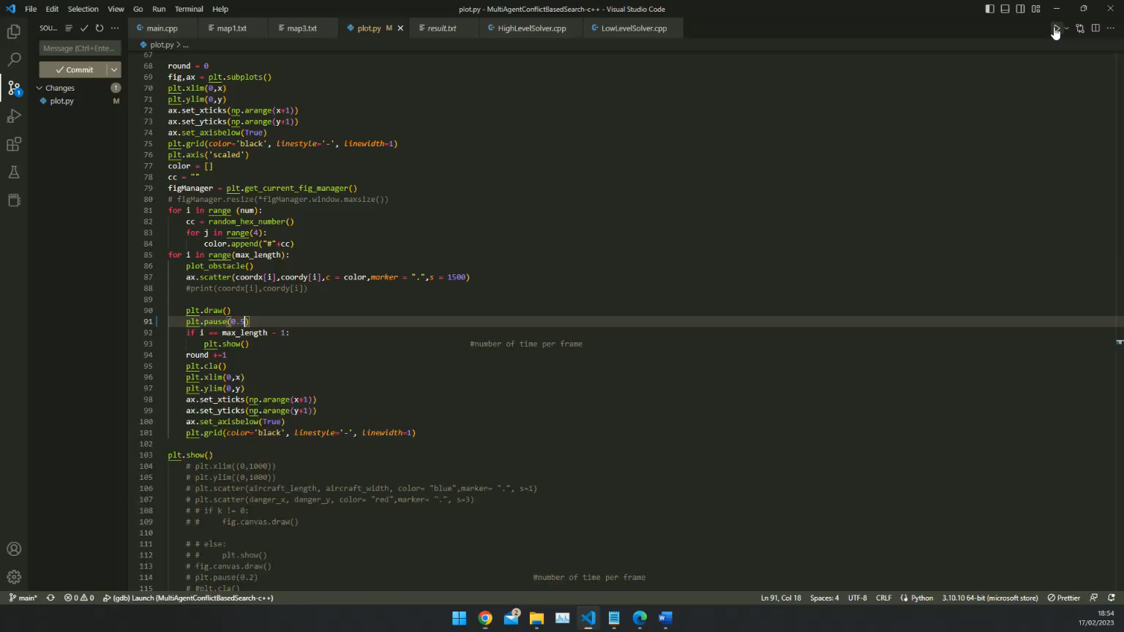
Formation in MAPF-F
Conventional MAPF does not work with the formation, conflict is different
Use lead-follower mode
Check possible collisions in A* search, boundary detection, and conflict detection
Notes:
Can’t mapf
Conflict different
Adapt mapf to mapff
reduce

Slide 19
Edge conflict example 1
 | Agent 1 | Agent 2
N | 1,7 | 3,7
N+1 | 2,7 | 3,7
N+2 | 3,7 | 2,7
N+3 | 4,7 | 2,7
N+4 | 5,7 | 1,7

Slide 20
Edge conflict example 1
 | Agent 1 | Agent 2
N | 1,7 | 3,7
N+1 | 2,7 | 3,7
N+2 | 2,8 | 2,7
N+3 | 3,8 | 2,7
N+4 | 3,7 | 1,7

Slide 21
Edge conflict example 2
 | Agent B size 0 | Agent A size 3
N | 1,7 | 2,6
N+1 | 2,7 | 2,5
N+2 | 2,8 | 2,4
N+3 | 3,8 | 2,3
N+4 | 3,7 | 2,2
A4
A3
A1
A2
B

Slide 22
Edge conflict example 2
 | Agent B size 0 | Agent A size 3
N | 1,7 | 2,6 2,9 5,6 5,9
N+1 | 2,7 | 2,5 2,8 5,5 5,8
N+2 | 2,8 | 2,4 2,7 5,4 5,7
N+3 | 3,8 | 2,3 2,6 5,3 5,6
N+4 | 3,7 | 2,2 2,5 5,2 5,5

Slide 23
Find best node in constraint tree

Slide 24
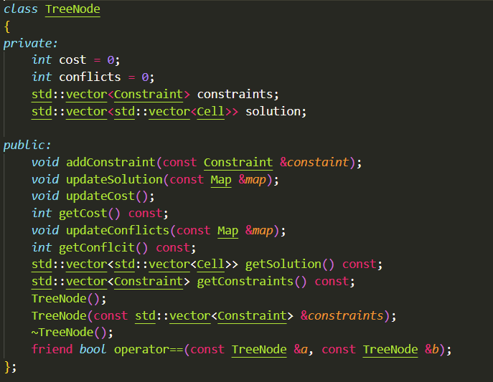
Find best node in constraint tree
What is in each node:

Slide 25
Conflicts/Cost
 | Min cost /ms | Max cost/ms | Min conflict/ms | Max conflict/ms
4 | 37155 | 16309 | 15280 | N/A
1 | 200 | 95 | 97 | 247
3 | 508 | 491 | 193 | 497
Notes:
Selection of node,

Slide 26
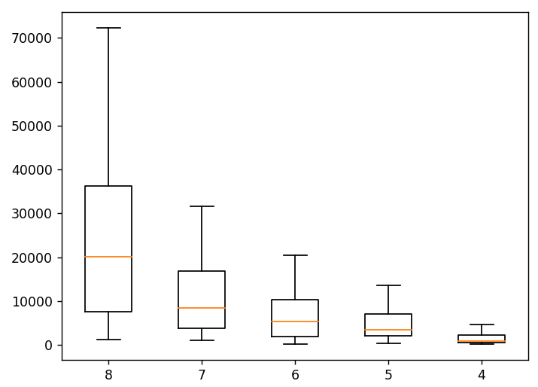
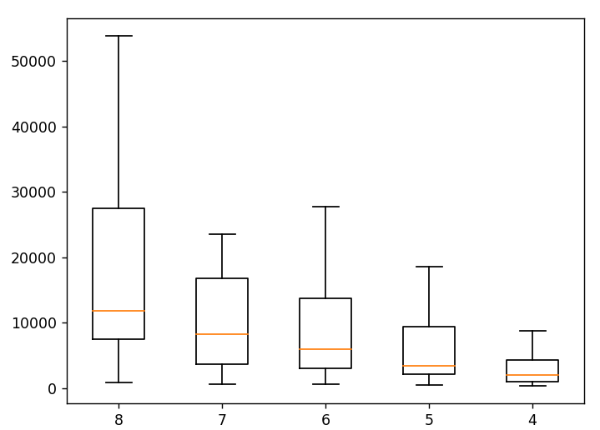
Time/ms
Time/ms
No. group of robots
No. group of robots

Slide 27
Future work
3D
Shape changing

